Slide 1
Go-LD : Software Tool For Go
Jude Haris
Supervised by John O’Donnell

Slide 2
Project Aims
Create tool for Go players to play through and solve Life and Death Go problems
Create a “computer” player which able to play and solve the problems
The “computer” player should be able to play against the user and itself

Slide 3
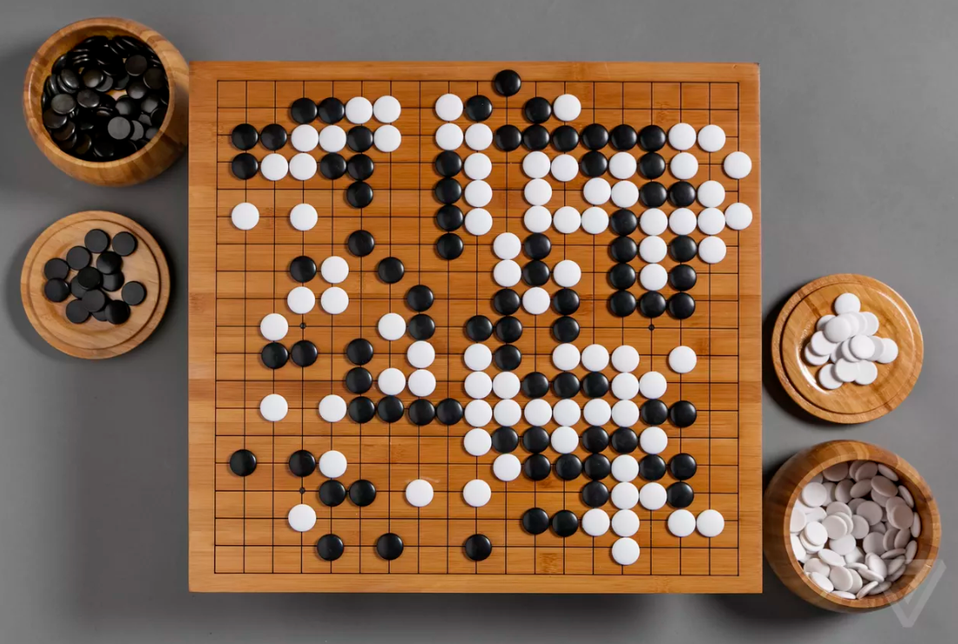

Slide 4
Go - How it is Played
Two player turn based board game - (Black and White)
Places stones (i.e. the pieces) on the intersections not between them
Objective is to surround as much territory as possible
Keep playing until both players agrees there are no good more moves to be played
At the end the player with more territory wins

Slide 5
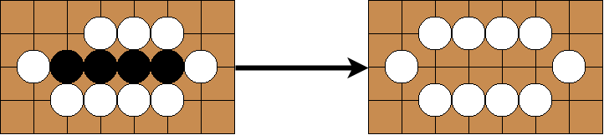
Go - Capturing

Slide 6
Other Rules
Self Capturing – Restrict the players from making suicidal moves
Ko Rule – Slightly complicated rule which disallows repetition of the same board position

Slide 7
Go-LD
Go-LD consists of 3 main components
Play Mode
Editor Mode
“The Computer”
Contains 3 screens
Title Screen
Play Screen
Editor Screen

Slide 8
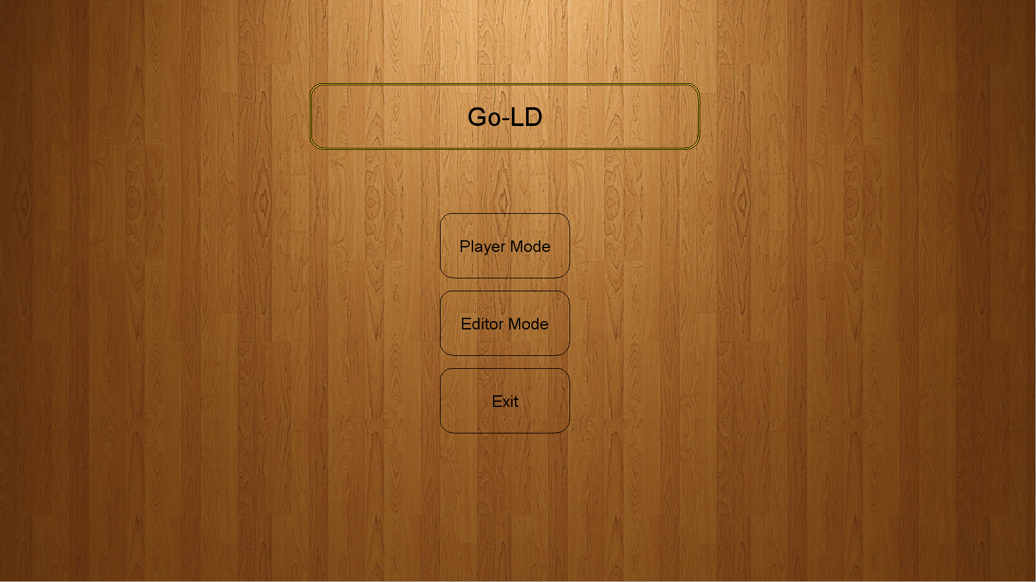

Slide 9
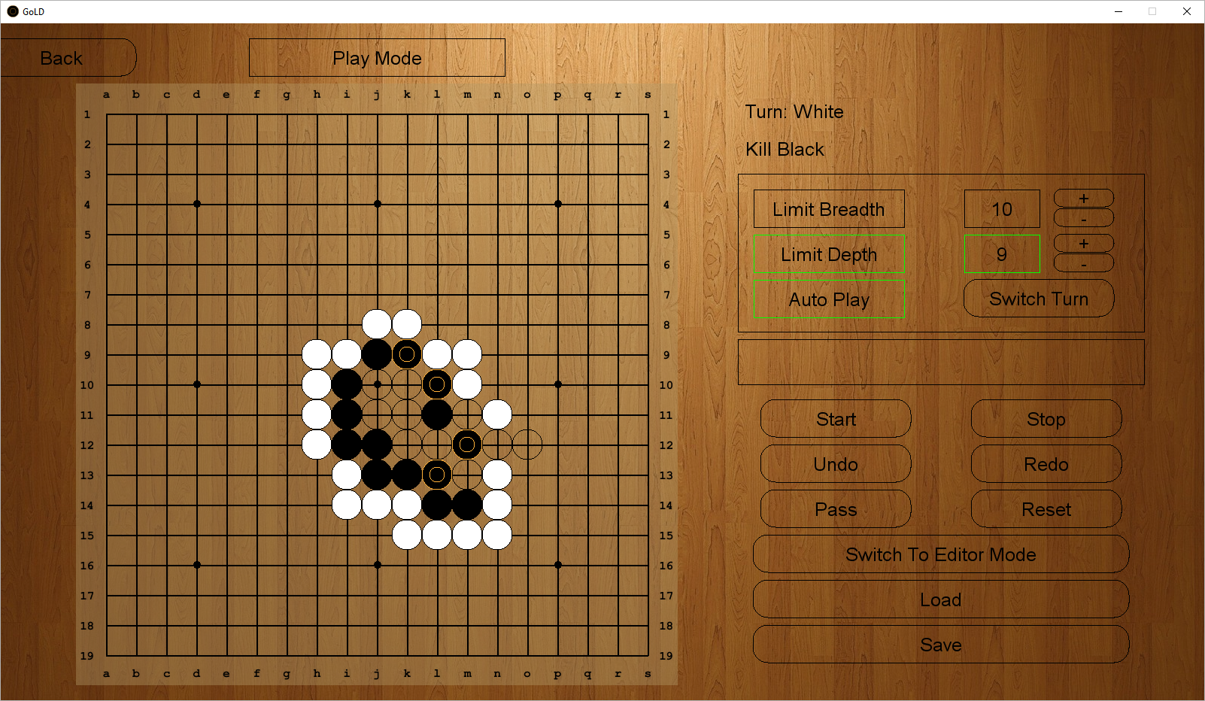

Slide 10
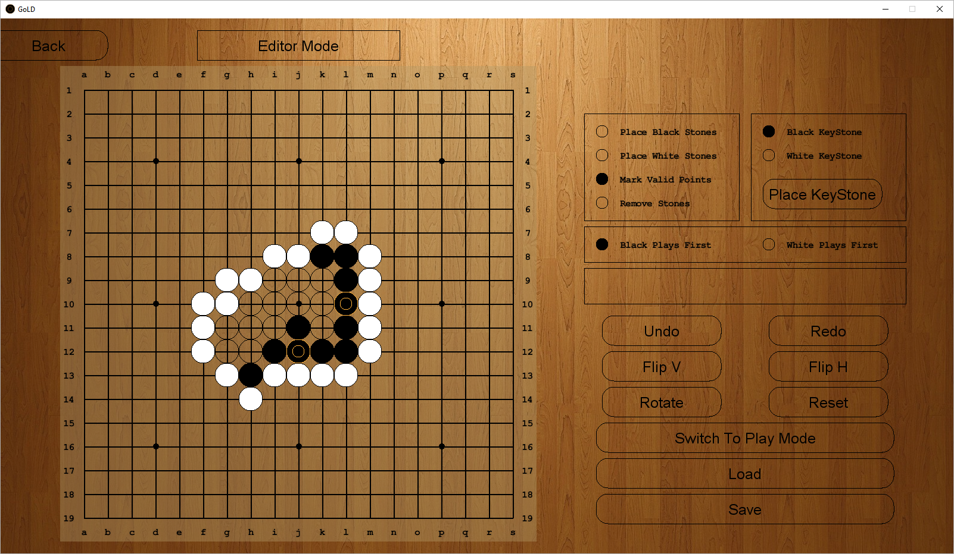

Slide 11
“The Computer”
Uses a Tree Search to find the best move
Tree Search Timeline:
Minimax – Used during the initial phase of the project
Alpha-Beta Pruning Search – Minimax was later adapted into the Alpha-Pruning Search
Alpha-Beta Pruning with Iterative Deepening – Even later on the project , Iterative Deepening was augmented on to the Alpha-Beta Pruning search
Board Evaluation
Move Generation
Move Ordering

Slide 12
Board Evaluation
Pattern-Based Heuristic
Pre-defined patterns
Checks board for these patterns
Adds value of each pattern found on to the overall total score of the board
Liberty Count Heuristic
Simply counts the total liberty of both colours of stones
Score is added on to board depending on the difference in total liberties for black and white

Slide 13
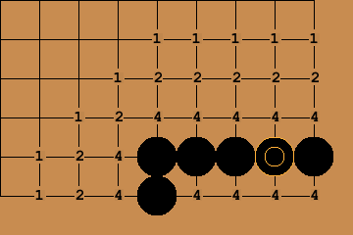
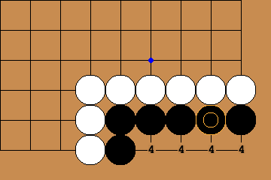
Move Generator
Generators a subset of moves to be searched from the all the valid moves
Distance Based Move Gen
Prioritises moves near the keystones and the stones connected to them
Enemy stones in between a move and keystone decreases the move priority
Keystone
Keystone

Slide 14
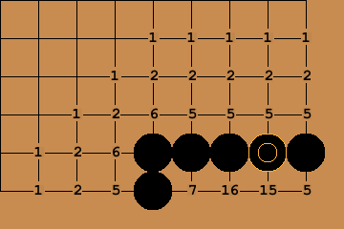

Move Generator
Pattern-Matching Move Gen
Looks for occurrences of pre-defined patterns on the board
Gives move priority to moves which play on the vital points of the pre-defined patterns
Vital Points
Vital Points

Slide 15
Move Ordering
Better move ordering yields more Alpha-Beta cut-offs
More cut-offs = lesser search time
The Killer Move Heuristic
The Principal Variation Heuristic

Slide 16
Evaluation Phase & Results
Beta Testing
Provided tester with small brief and a step by step tutorial to introduce them to the program
Provided testers with two sets of problems ~100 problems
Tester found functionality all working
Some issues with the interface
Performance Evaluation
Re-created problems found online
Collected relevant data for each solvable problem
Iterative Deepening found to better than fixed depth search for problems which took more than 10s
Overall best default depth setting was found to be 6

Slide 17
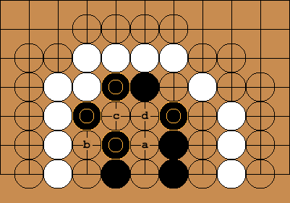
Example Problem- Black To Live

Slide 18
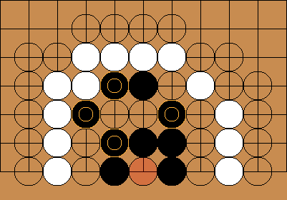
Black – Computer’s Turn

Slide 19
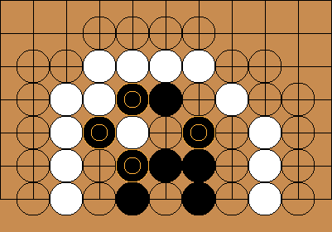
White - Human's Turn

Slide 20
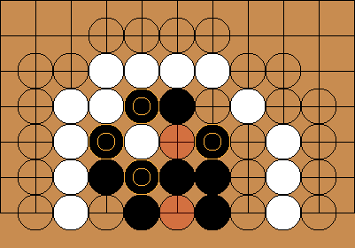
Black – Computer’s Turn

Slide 21
Conclusion

Slide 22
Questions?

Slide 23
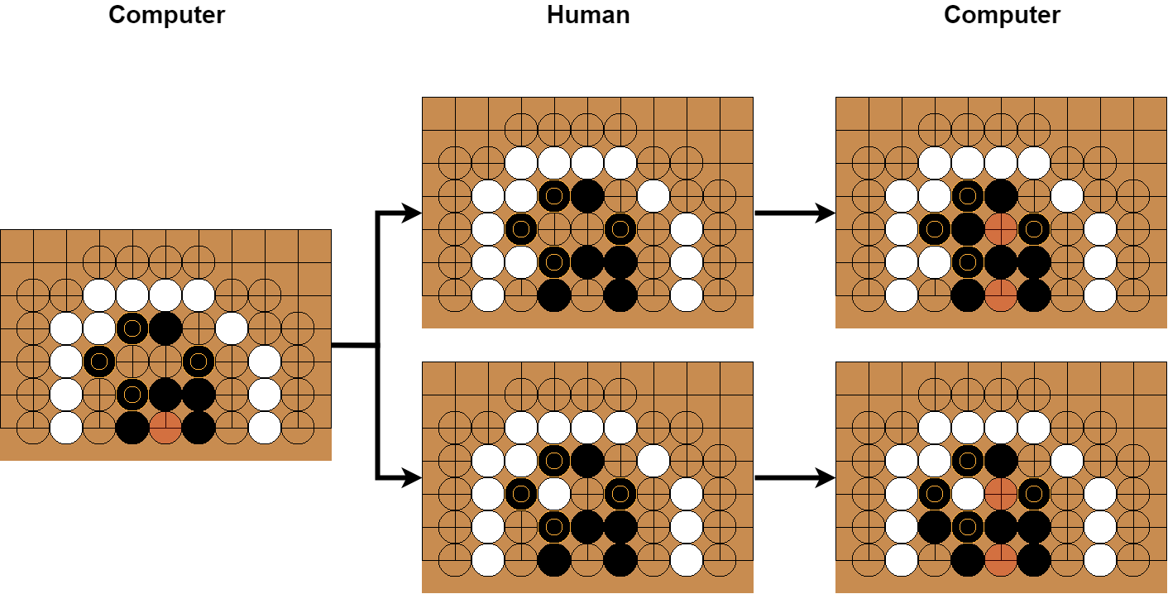
Example Problem - Both Variations

Slide 24
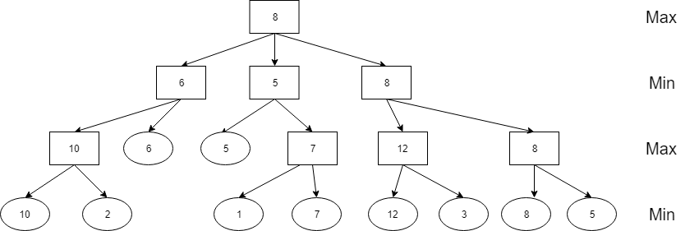
Minimax Tree Search

Slide 25
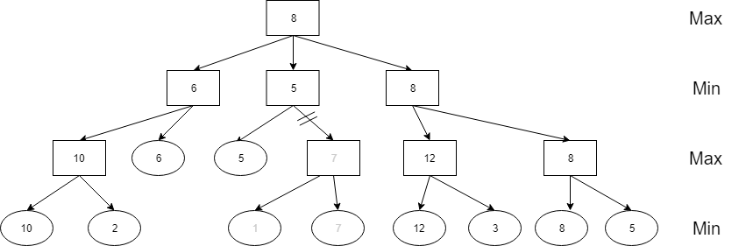
Alpha-Beta Pruning Tree Search
Subtree A
Subtree B

Slide 26
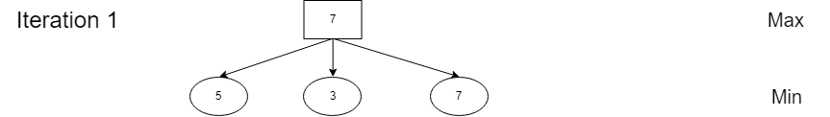
AB with Iterative Deepening

Slide 27
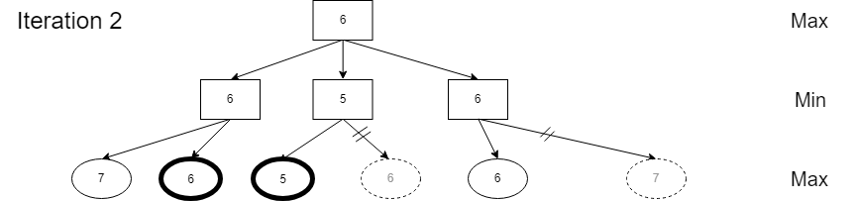
AB with Iterative Deepening

Slide 28
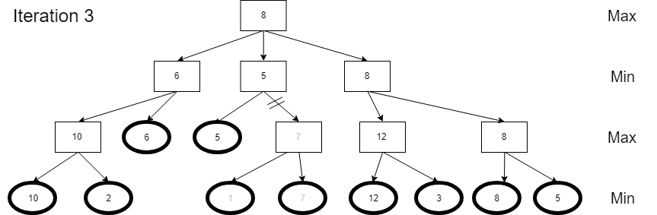
AB with Iterative Deepening

Slide 29
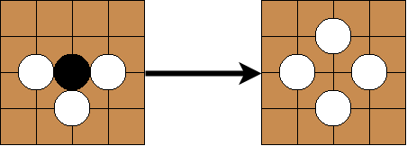
Go - Capturing

Slide 30
Life and Death Problems
Group of stones are under pressure of being captured
Life and Death battles dictates whether the group lives or dies
These areas on the board are vital in determining the victor
Better at Life and Death problems = Better at Go

Slide 31
